Slide 1

Tax Invoice Generator
Streamlining Invoicing Processes

Slide 2
TEAM MEMBERS
ADITYA AJAY SINGH
SAHIL MANOJ PANDEY
PRITVI PRASAD
RUGVEDI PATIL

Slide 3
TOPICS COVERED
INTRODUCTION
OBJECTIVE
CHALLENGES FACED
PROBLEM DEFINATION,MOTIVARION
LITERATURE SURVEY
METHODOLOGY
BASIC INFORMATION ABOUT PROJECT
CONCLUSION

Slide 4
Introduction
Aims to simplify and streamline the invoicing processes.
Streamline your invoicing processes for user-friendly experience.
Explore cutting-edge features crafted to meet the evolving needs of modern businesses.
Designed with you in mind, our project prioritizes ease of use and accessibility.

Slide 5

Objectives
Efficiency Boost : Streamline tax invoice generation. Reduce time and effort.
Business Alignment : Align with broader business goals. Enhance organizational processes.
Measurable Success : Set clear, measurable outcomes. Track user satisfaction.
User-Centric Design : Prioritize intuitive, user-friendly interfaces.Adapt to diverse user needs.
Technological Edge : Integrated with cutting-edge technologies .

Slide 6
Challenges
Customization: Offering customizable invoice templates to accommodate different business needs and branding preferences can be complex. Websites need to provide flexibility while maintaining consistency and professionalism in the generated invoices.
Compliance: Staying compliant with various regulations like GDPR, CCPA, and PCI DSS is essential. Websites must ensure that they handle customer data responsibly and adhere to legal requirements regarding data protection and privacy.
Security: Ensuring the security of sensitive customer information such as names, addresses, and payment details is crucial. Websites must protect against data breaches and implement encryption methods to safeguard data both in transit and at rest.
Internationalization: Serving customers globally means dealing with different currencies, languages, and tax regulations. Websites need to support multi-currency invoicing, multilingual interfaces, and compliance with diverse tax laws.
Automation: Automating the invoice generation process saves time and reduces errors. However, implementing robust automation features, such as recurring billing or scheduled invoicing, requires careful planning and testing.

Slide 7
Problem Definition and Motivation
Problem Definition:
Invoicing processes often prove cumbersome, prone to errors, and lacking in efficiency.
The existing solutions are characterized by complexity and steep learning curves, hindering a smooth workflow.
Motivation for the Project: The Tax Invoice Generator emerges from a drive to simplify and expedite invoicing.
By prioritizing a user-centric approach, it aims to create an accessible interface, embracing technological innovation to enhance efficiency and competitiveness.

Slide 8

Literature Survey
Informed Innovation
Our exploration of existing literature unveiled diverse approaches to tax invoice generation.
We identified best practices, drawing inspiration from successful systems.
Additionally, our focus extended to incorporating innovative trends, ensuring the Tax Invoice Generator aligns with both proven methods and cutting-edge technologies.

Slide 9
Methodology
1. Research : Conducted thorough market research. Analyzed existing solutions and user feedback.
1
2. Design : Collaborated with stakeholders to define requirements. Iteratively designed user-friendly interfaces.
2
3. Development : Employed agile methodologies for rapid iteration. Implemented robust testing protocols for quality assurance.
3
4. Deployment : Rolled out the Tax Invoice Generator in phases. Conducted user training sessions for seamless adoption
4

Slide 10

Payment Options
The Tax Invoice Generator provides users with diverse payment options.
Choose from UPI, credit/debit cards, or cash.
This flexibility caters to the varied preferences of users and ensures a seamless payment experience.

Slide 11

QR Code Generation
For UPI payments, the Tax Invoice Generator dynamically generates a QR code based on the entered amount.
This QR code facilitates quick and secure UPI transactions, providing a convenient payment option for users.

Slide 12

PDF Invoice Generation
Efficient Record-Keeping Instantly generate PDF invoices upon form submission, ensuring efficient record-keeping for seamless financial management.
Upon submitting the form, the entered invoice details are stored locally, and a PDF invoice is generated. This feature ensures efficient record-keeping for users.

Slide 13
Styling
The webpage is styled using CSS to provide a visually appealing layout.
Background images, font styles, and form aesthetics are defined in the CSS section, ensuring an attractive and user-friendly interface.

Slide 14
JavaScript Functionality
JavaScript is utilized to handle form submission, checkbox events, QR code generation, PDF generation, and timer functionality for the QR code display.
This ensures a seamless and interactive user experience.

Slide 15
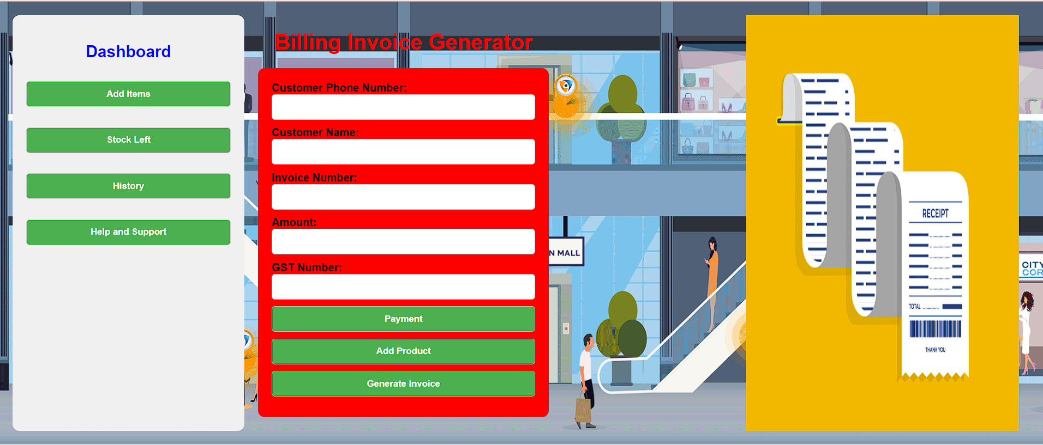

Slide 16


Slide 17
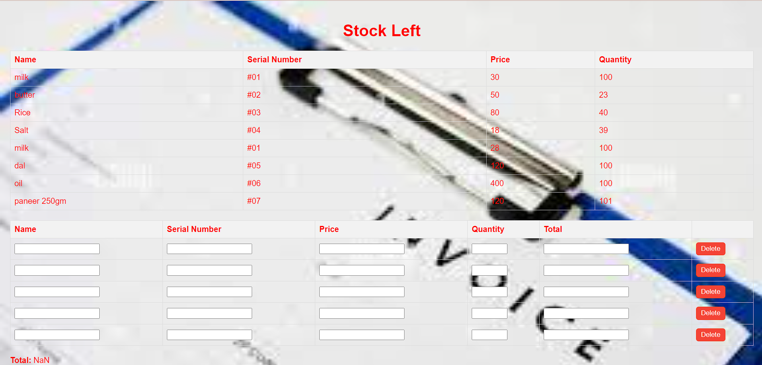

Slide 18


Slide 19

Conclusion
In conclusion, the Tax Invoice Generator represents a significant leap forward in streamlining invoicing processes.
With its user-centric design, technological innovation, and commitment to efficiency, it stands poised to redefine the landscape of financial management.
Embrace the future of invoicing with our innovative solution and experience the difference firsthand.

